Slide 1

The Evolution and Anatomy of…

Slide 2
I n t r o d u c t
I o n s

Slide 3
I n t r o d u c t
I o n s
Ben Carhart
  Requirements Lead, Quality Assurance, Testing Lead
  Debugger, Permissions
David Czechowski
  Design Lead, Configuration Management
  Networking, Compiler
Mark Erikson
  Team Lead, Project Lead
  GUI, Editor, Terminal
Notes:
Ben:
-Requirements: not much to do
-Quality & Testing: beta, (release schedule)
David:
-Design Lead: “Mark, does it make sense?”, Abstract! Abstract!
-Config Management: server (dotProj, cvs, file, web – live documentation)
Mark:
-Team Lead: Main contact with Dr. Shomper (updates outside of full-team customer meetings)
-Project Lead: jack of all trades, biggest overview of the codebase

Slide 4
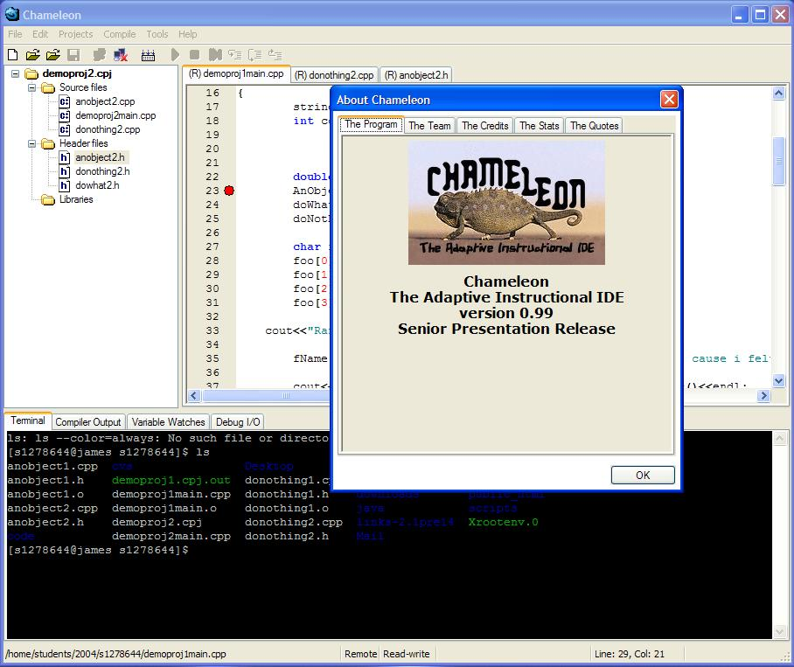
I n t r o d u c t
I o n
Chameleon
Notes:
An Integrated Development Environment – collection of tools to assist with code development
… that adapts – specifically for instructional purposes
It provides an environment that an introductory computer science student can be comfortable in, and also have the ability to adaptively grow more complex as the skill and functionality needs of the student advance.

Slide 5
R e q u
I r e m e n t s

Slide 6
R e q u
I r e m e n t s
Major – What we absolutely needed to have
  General editor features
  Embedded Terminal
  Compiling
  Feature enabling/disabling
  Network Transparency
Notes:
What to say:
Requirements: These have changed a bit based on what we realized we could do and couldn’t do, but there have always been ones we were getting into the program come hell or high water.
*Major
*General editor features = these are your basic “type text, cut, copy, paste, search, replace” things. Simple, yes, but NEEDED.
*Embedded Terminal = a prime requirement of this was to have an IDE with some form of a linux command prompt built in. Purpose is to expose the student to Linux; a base feature of our Computer Science program here. We have succeeded marvelously.
*Compiling = an IDE isn’t much without a compiler. We have a successfully interfaced with the GNU compiler GCC
*Feature enabling Disabling = as stated in our title, “Adaptive Instructional IDE”, the entire reason for there being a “Chameleon IDE” is because it can shrink itself down to “notepad” and then bring itself back up to “Visual Studio” with a few clicks, and hit every pothole in between! This was the entire reason for this project because editors like “Visual Studio” are so complex that they can be frightening to green computer programmers, but necessary for experienced veterans. And at the same time, editors like “vi”… are almost prohibitive in their simplicity. Chameleon bridges the gap between the two by allowing the professor to set where the students are… from a notepad-like editor to a full studio. Personally I can say this was the easiest part of the project to do, and the only one I accomplished within my estimated time outlook!
*Network Transparency = edit files that exist on a remote server

Slide 7
R e q u
I r e m e n t s
Peripheral – The “would be nice” features that made it
  Debugger
  Projects
  Editor goodies
  Professor Program
  .
  .
Notes:
What to say:
*Peripheral = these are still requirements, but were less vital to completion than the above. As a team we wanted them, and we got them.
*Debugger = we have successfully interfaced with GNU’s open source debugger “GDB” in one of the most intensive and cooperative coding runs in the entire project. We’ve all helped each other in some manner through the entire project, but here, I think, we had the most cooperation and teamwork come together to create the module. It’s position as a requirement stems from the natural fact that a code development environment is incomplete without the ability to step through code and see what’s going on.
*Projects = very few medium – to – large scale projects are just one file. Therefore some form of project support was anticipated. And much like Visual Studio, everything in Chameleon is a project. Much of it is transparent though.
*Editor goodies = the A.1. on the steak; the butter in the baked potato. Syntax highlighting and auto-indentation in the text. An IDE just isn’t the same without it
*Professor Program = the whole feature enabling / disabling requirement wouldn’t be worth much without a program giving the professor the ability to enable and disable the features. This is lowest on the list because once the first major requirement was taken care of, making a small program to reverse the process was extremely trivial.
*___ = hmmm, I guess there’s one we forgot to mention (Adv. Comp. Output)
*____ = hmmm, I guess there’s another we forgot to mention (Debugging I/O)

Slide 8
D e s i g n

Slide 9
D e s i g n
Key Points
  Object Oriented Design
  Module-Per-Major Feature
    Abstraction
    Concurrent Development
  Off-the-Shelf Re-use
Notes:
Object Oriented Design: independent objects passing messages back and forth
Object Module-Per-Major Feature: allowed for
-abstraction of problems and redesigns
-and, concurrent development
Off-The-Shelf: wxWindows GUI Toolkit, Scintilla Editor Widget, wxTerm widget from taTelnet, PLink, PScp, GNU Debugger, GNU Compiler

Slide 10
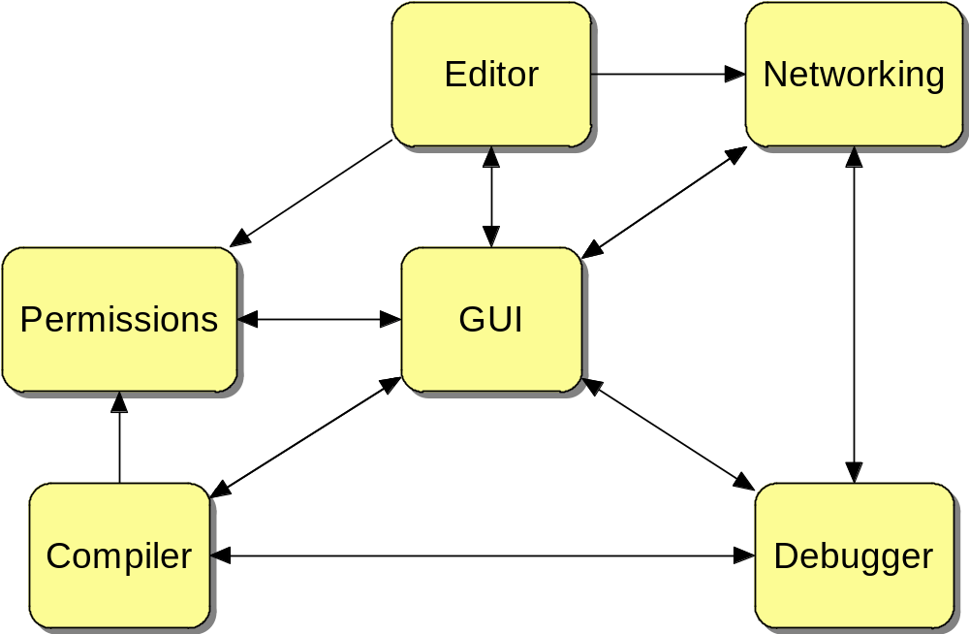
D
e
s
i
g
n

Slide 11
D
e
s
i
g
n
Editor(s)
Permissions
Networking
GUI
Compiler
Debugger

Slide 12
D
e
s
i
g
n
Editor(s)
Permissions
Networking
GUI
Compiler
Debugger

Slide 13
D
e
s
i
g
n
Editor(s)
Permissions
& Options
Networking
GUI
Compiler
Debugger
Project
Management

Slide 14
D
e
s
i
g
n
Editor(s)
Permissions
& Options
Networking
GUI
Compiler
Debugger
Project
Management
Notes:
User Input & Display

Slide 15
D
e
s
i
g
n
Editor(s)
Permissions
& Options
Networking
GUI
Compiler
Debugger
Project
Management
Notes:
Code Flow

Slide 16
A c h i e v e m e n t s

Slide 17
A c h i e v e m e n t s
Create a C++ programmer’s editor with the usual features
  Not too dificult, particularly because the concept has been done hundreds of times
  Mainly accomplished by using the Scintilla editor widget
Adapt the editor’s abilities as the professor sees fit
  Permissions module, mian application, and professor’s program
  Not too hard – mostly just show/hide appropriate items
Work with files on a remote Linux server
  Our first big challenge
  Accomplished with slieght-of-hand, using PSCP
Terminal capabilities built into the program itself
  Third-party wxTerm class, heavily customized
  SSH issues
  Terminal history
Notes:
Not only are there hundreds of programmer’s editors, there were several examples using wxStyledTextCtrl.
We updated the permissions module partway through to give better security. Originally we were using a simple bitmask, which was vulnerable to the user typing in random numbers. We eventually augmented it with a CRC to give better security – this isn’t a life-and-death situation, but it didn’t hurt.
The actual functionality changes are done in two ways – major widgets are hidden or displayed as necessary, and stuff like the toolbar, menubar, and terminal notebook control are simply wiped clean and items are added back in based on the updated options.
We had some initial issues with remote file I/O due to the technique we were using, which was piping files back and forth over SSH. This wasn’t a big deal for opening them, but saving didn’t work right because of character escapes and such. We eventually gave up on that for saving and switched to saving to a temporary file, copying the temporary to the remote server with PSCP, and deleting the temp file. Opening is still done with SSH piping, since it’s trivial.
The built-in Windows file dialog works fine for local files, or even files shared on the network, but it’s completely incapable of handling what we’re doing – listing files inside a user’s home directory on a remote server. I had to write a file dialog from scratch, which turned out to be more involved than I thought. Still, the final result works pretty well.
The terminal wouldn’t really have been possible without the wxTerm class that we found. It proved to be almost exactly what we needed. It was originally designed to do Telnet over sockets. There were two main challenges.
One was converting it to a true SSH connection. We didn’t have to change much code in wxTerm itself. The majority of the work for that actually took place in the networking module. David wrote an event-based I/O system that uses the Plink command-line SSH client for the actual connection and redirects Plink’s I/O to Chameleon.
The other main issue was terminal scrolling. If wxTerm received more text than could be displayed at one time, the old text would disappear permanently. I spent way too many hours poring through the wxTerm code, trying to figure out enough of what was being done to come up with a replacement for the internal text management. I finally managed to come up with a replacement text management system that handled the scrolling itself, while keeping the rest of the wxTerm code the same

Slide 18
A c h i e v e m e n t s
Network module
  Not a major feature, but a vital component
  First version mostly worked, had issues
  Rewrite gave better speed, more versatility
Compiling
  Not incredibly complicated
  Rewritten to use the New Networking API
Integrated Debugger
  Wrapper around GDB
  Had to be able to interact with GDB locally and remotely
  Lots of parsing issues
Multi-File Projects
  Went from really trivial to reasonably complex
  Closely linked to the Compiling rewrite
Notes:
Almost all of Chameleon depends on the Networking module. It abstracts out the details of local and remote processes, handles all the remote I/O, retrieves directory listings for the RemoteFileDialog, and more.
Networking actually went through a couple of redesigns and a major rewrite, which we just integrated in the last week. The previous version worked decently, but we had some issues with network latency and memory leaks. In addition, large portions of it were synchronous and could block user interaction. The final version is almost entirely asynchronous, cuts down dramatically on latency, and solves our problems with memory leaks.
The general concept of compiling was pretty straightforward – put together a command line and start the compiler. Our first version worked, but was extremely limited. After Networking was rewritten, David rewrote compiling to work with both the new Networking API and the revised project class.
From the beginning, one of our main goals was to have an integrated debugger. This was an interesting challenge, because the debugger required the rest of the program to be there, but the main program could work just fine without the debugger. Ben basically was sent off to work on the debugger while David and I worked on the main program, with the hope that our two tracks would eventually converge. We had some worries, but Ben really came through.
We were initially worried about the need to run GDB on the remote server, since that’s where the user’s program was. Fortunately, the Networking module abstracted that out well, allowing Ben to focus on actually interacting with GDB.
Ben wound up designing the debugger as a state machine, which expects certain types of output from GDB based on what’s been sent. Output parsing is mostly handled through regular expressions. Interaction with the main program is completely event-driven, which is needed due to the asynchronous nature of the GDB output.
Project handling starting out as just a collection of a few pieces of information, and eventually morphed into a much large and more involved concept that’s used by the main program, the compiler, and the editor. Our design came somewhat late in the semester, but we’re really happy with what we came up with. (we even consider each independently opened file to be a “project”)

Slide 19
S t a t u s

Slide 20
S t a t u s
Outstanding Tasks:
  Local functionality (20%)
  Documentation (85%)
  Installation Program (25%)
On-Going:
  Bug Fixes
  Additional Tweaks
Notes:
Outstanding Tasks: things Dr. Shomper still demands from us
Local –the abstraction of processes (not knowing if they are local or remote) should make this easy. Mingw
Documentation – We’ve already started our final work-over, to bring things up to date with what Chameleon really is
Installation Program – currently: download 3 executables (plink,pscp, chamel), like to wrap that because some libraries are also needed
On Going: things we’ll be doing from now till…
Final Presentation
Bug Fixes – you never finish a product, you just run out of time
Additional Tweaks – blah blah

Slide 21
D e mo n s t r a t
I o n

Slide 22
D
e
m
o
n
s
t
r
a
t
i
o
n
The moment of truth…
Notes:
For the CS students, if this seems boring, it means we’ve done a good job of making a tool ya’ll could feel at home using.

Slide 23
Q u e s t
I o n s

Slide 24

Q
u
e
s
t
i
o
n
s

Slide 25
THE FUTURE
chameleon evolution

Slide 26
T h e
F u t ur e

Slide 27
T h e
F u t u r e
Room for Improvement?
  Editor Enhancements
    Auto-completion / Member Completion
    Code folding
    Syntax Highlighting Customization
  Debugger enhancements
    Dynamic variable watching
    Automatic local variable watching
    Advanced Variable Display
Notes:
How could Chameleon Evolve later in life?
*Given that this project was a learning-in-progress as well as a program-in-progress, there are things we were unable to get done, but would have liked to. Our documentation (Maint. Manual) as well as comments in our source code should allow future programmers to pick up where we left off. Even if those programmers are ourselves fifteen years down the road.
This is a list of tweaks, optimizations, or additional features that could be added in using the core that you’ve just seen.
*Editor
*Auto-Completion = Mark is bitting at the bit to get this done. It’s a lot more complex than originally conceived, but would be a very nice feature to add for a more professional flavor.
*Code Folding
*Syntax Highlighting = currently the syntax highlighting is stuck at whatever Mark set it as, for better, for worse.
*Debugger
*Dynamic Var Watch = Currently we have a very simple version of variable watching. Some time it’d be nice to take advantage of GDB’s built-in “display” command so that variables being watched could vanish & reappear magically as they moved in/out of scope.
*Automatic Var Watch = Another professional flavor, our debugger does not automatically watch local variables like VC does.
*Advanced Var Display = we can currenlty parse most things you throw at the debugger, but we only grab the ENTIRE thing and display it. Breaking it into collapsable list items would be nice in the future.

Slide 28
The
Fu t ure
  Network Enhancements
    Reusable Connections
    Server-Side Terminal Resizing
    Directory Caching
    Server-based Options Management
    Integrate Plink
Notes:
*network
*Reusable connections = Currently a network connection is established “on demand”. Keeping a queue of connections that are already active would enhance performance
*Terminal Resize = An item we’re aware of with our terminal is that launched programs on the server will not display correctly. We knowa general way to fix it, but that’s something for a later date.
*Directory Cache = performance enhancement
*Server-based = for enhanced security & to prevent “social engineering” where freshman get full-access codes from seniors
*Plink integration = to cut down on the number of external programs we require

Slide 29
The
Fu t ure
  General
    Integration with “Debugginator” and “Virtual Professor”
    Password Saving
    Run-Execute vs. Run-Debugging
    Auto-save / Backup
    Port to Linux
Notes:
*general
*Integration = some cooperation between our programs was an original concept, but faded in favor of finishing the project
*Password Saving = a security issue we did not want to touch.
*Run = rather than having our “run” button activate the debugger only, include an option to execute the executable directly
*Auto-save
*Port to Linux = original design specs included both windows & linux versions, again abandoned in favor of project completion.
*Conclusion = There is much room for expansion, and hopefully with our code base, expanding should not be painful.

Slide 30
S u m m a r y

Slide 31
S u m m a r y
Lessons We’ve Learned
  The Importance of Code Re-Use
  The Importance of Detail in Design
  The Blessing/Curse of Testing
Notes:
In closing…
The importance of Code Reuse – this project would not have been possible without using the components that we did (each would have been a Sr. Project by itself)
The importance of Design before Code. Looking back (past presentation slides & documentation), we realize how clue-less to the details we were. If we had better planned/designed things out in the beginning…
Making releases that were “out in the wild” early on allowed us to know our real status. It also forced us to make our code more robust. It also revealed more bugs to us – not so much from the testers, but more so from “beating on it” ourselves.

